Slide 1
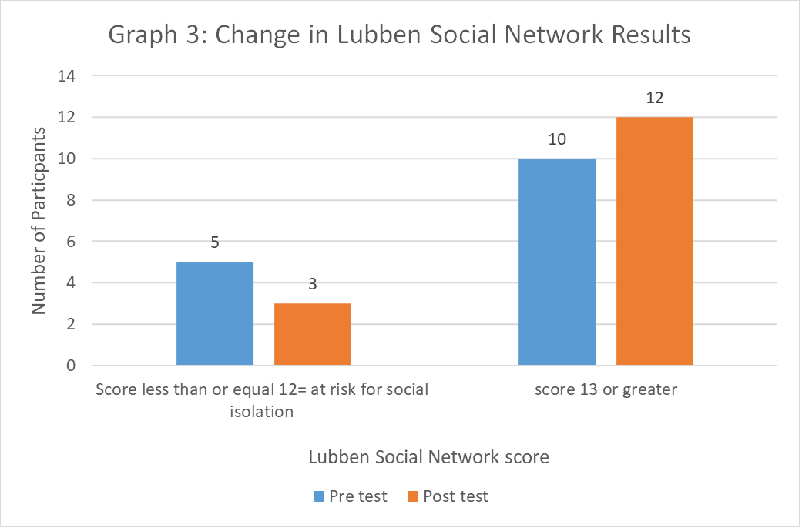
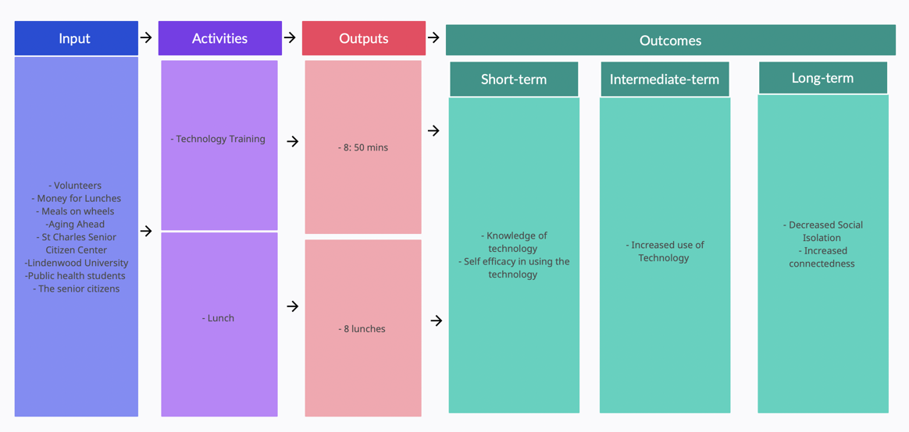
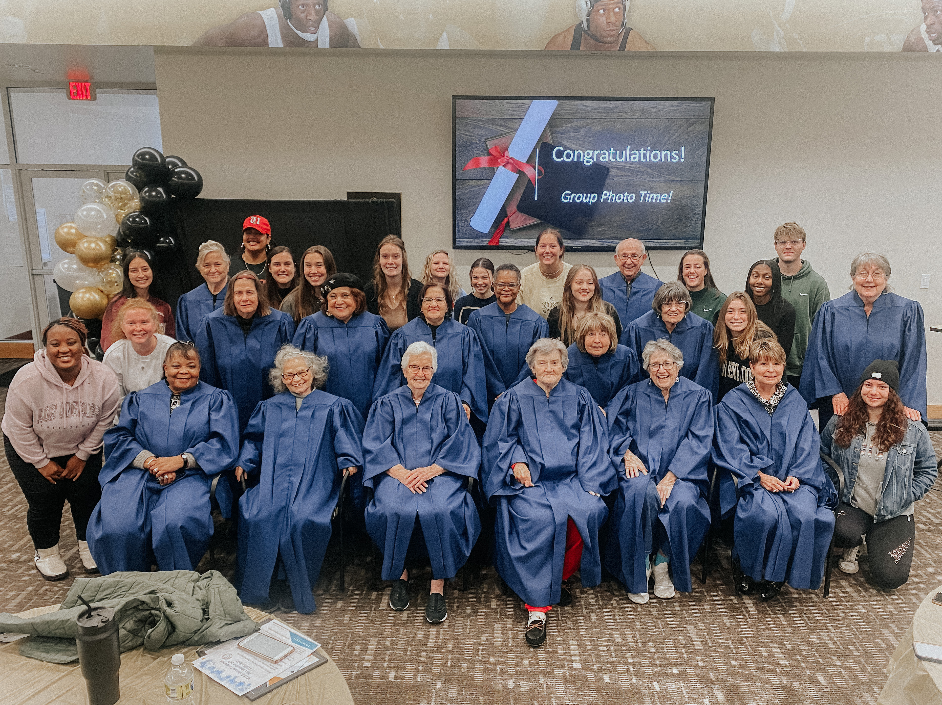
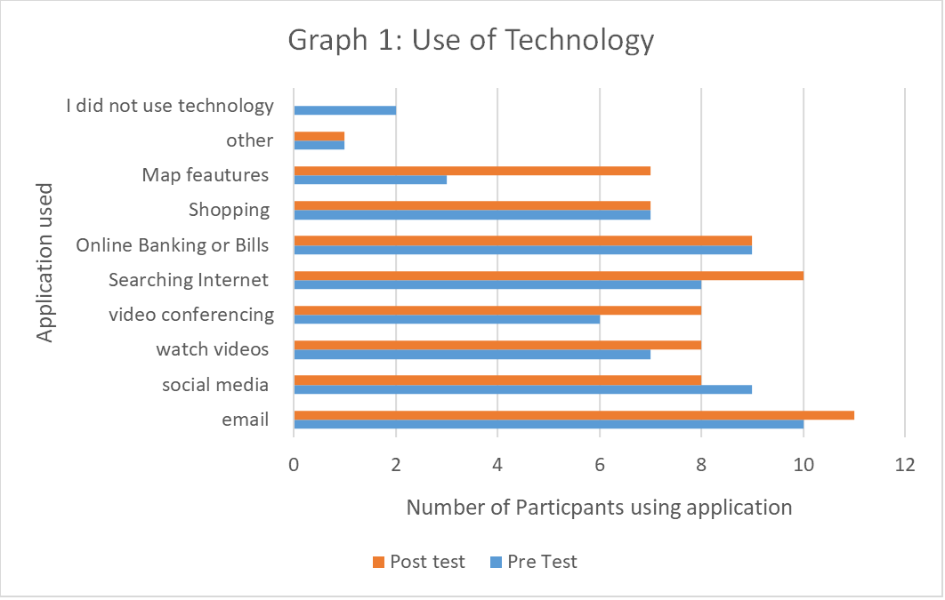
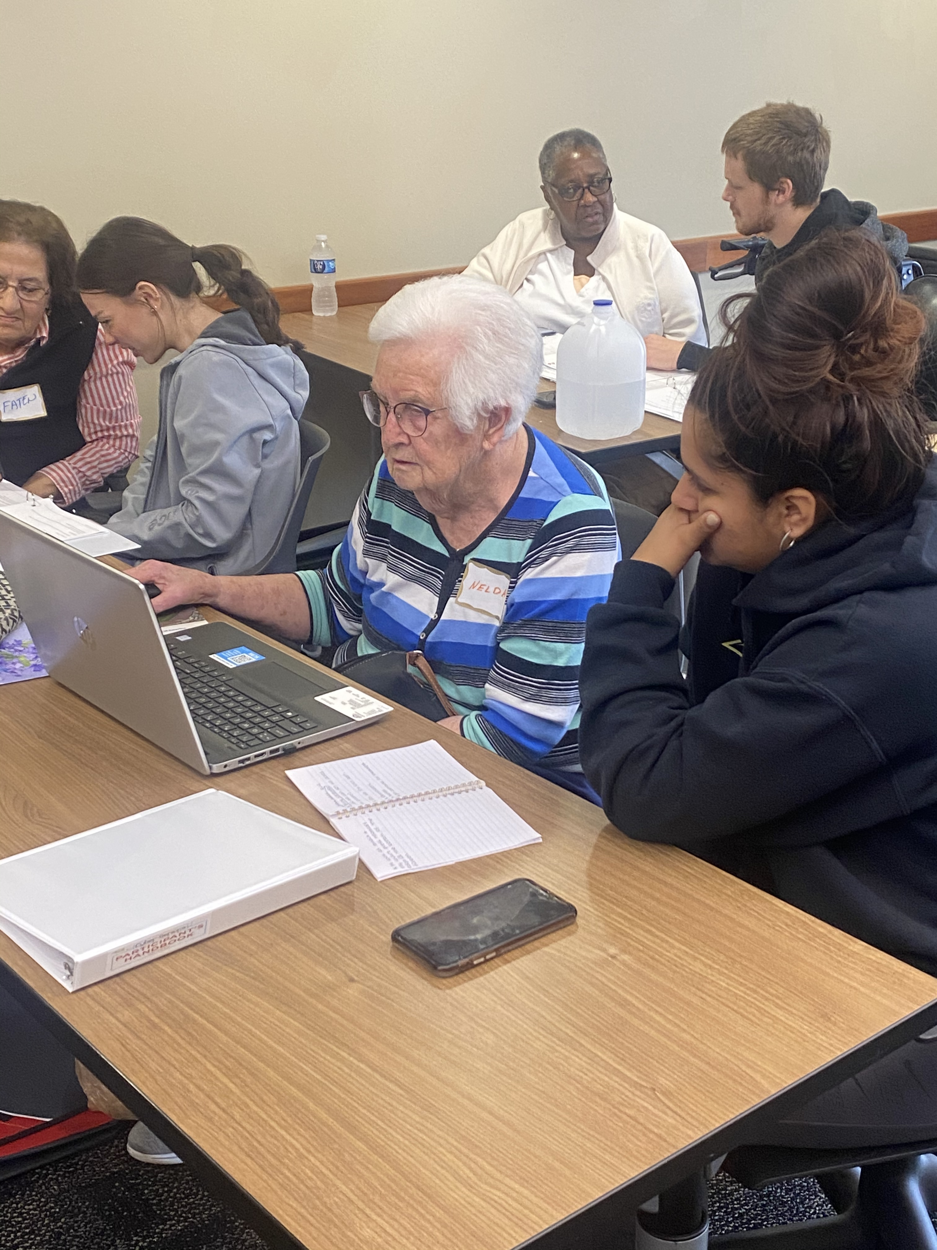
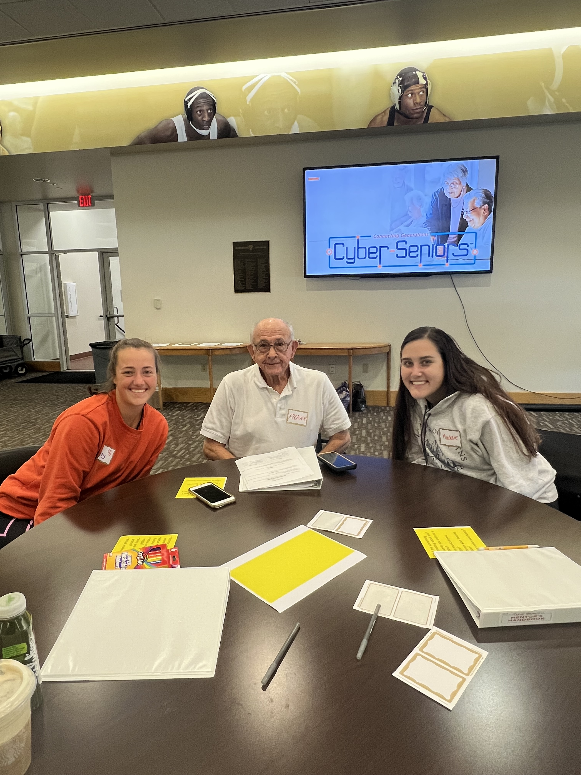
Program Evaluation of the Lindenwood University Cyber Seniors Program
By Isobel Folan, Sam Nudo
What is Cyber Seniors
Data Collection
Cyber Seniors was a pilot program, first offered at Lindenwood University in the Fall of 2022. This innovate program offers free technology training to seniors. College students act as trainers and mentors to help the seniors increase knowledge on how to use technology. Additionally, they build relationships to increase social connectedness and engagement while decreasing social isolation. For college students, the program helps them build connections with local organizations and explore potential careers.
1. Collected basic demographic data on all participants
2. Pretest survey
- Looked at what technology participants owned, how often they used it, and what they used it for
3. Post-test survey
-Included the same questions as the pre-test with extra questions on knowledge and self-efficacy
4. Social Support Lubben Scale
-Included 6 questions about participant's social connections with others (pre-test and post-test)
5. All data was collected using paper surveys
Logic Model
Next Steps for future Programs
Follow up form 6 month post program to assess knowledge, skills and social isolation
Capture data on change in self confidence for college students
Improve the data collection methods to ensure completeness of surveys.
Increase the length of the program
-Collaborate with technology companies such as Apple
Results
Process Findings
Program was implemented with fidelity:
- On average, 12.5 participants and 14 volunteers attended each week
- Missing data from week 6 from both participants and volunteers
- Eight, 50-minute technology training sessions occurred
Free Lunch :
-Don’t have accurate data on how many individuals received a free lunch
Overall feeling about the program
-66.7% of participants thought that the program was fantastic
-26.7% thought the program was very good
Goals and Aims of the Program
Outcome Findings
Knowledge and use of technology applications increase in all areas.
Participant report a 133% increase in knowledge and use of map functions on phones.
Unable to draw conclusions on confidence in application use
Social isolation decreased by 40%
Goal 1: Was the program well received by the participants?
Aim 1: During the program, 18 participants will receive one on one technology training for 50 minutes each.
Aim 2 During the program, all participants will receive a free lunch
Goal 2: Did the program improve technology knowledge and skills, and decrease social isolation among seniors?
Aim 3: By the end of the program all cyber seniors will have increased knowledge of applications available to them on their technology
Aim 4: By the end of the program, participants will increase their confidence to use applications on their technology.
Aim 5: By the end of the program, participants will report decreased social isolation.
Acknowledgements: Lindenwood University, Aging Ahead, Cyber Seniors, St Charles Senior Citizen Center, St Charles Senior Council, Lindenwell, Dr. Alameda, Dr. Shoff

