Slide 1
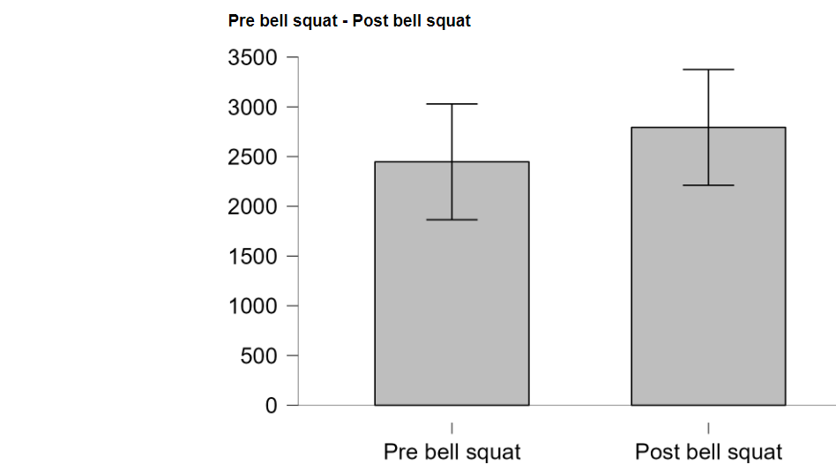
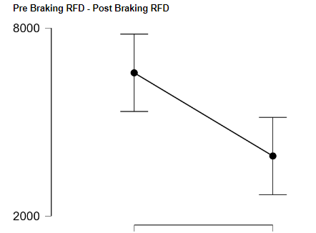
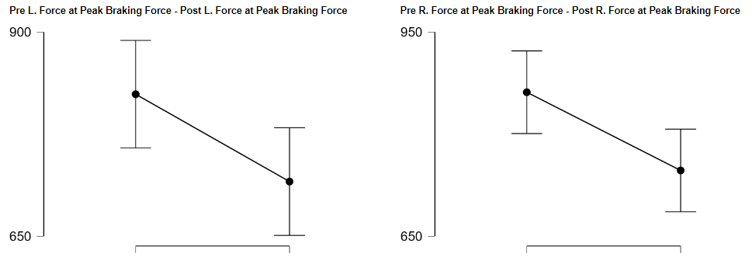
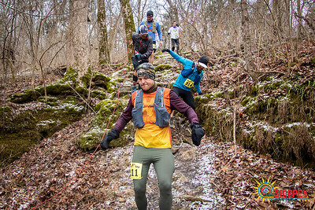
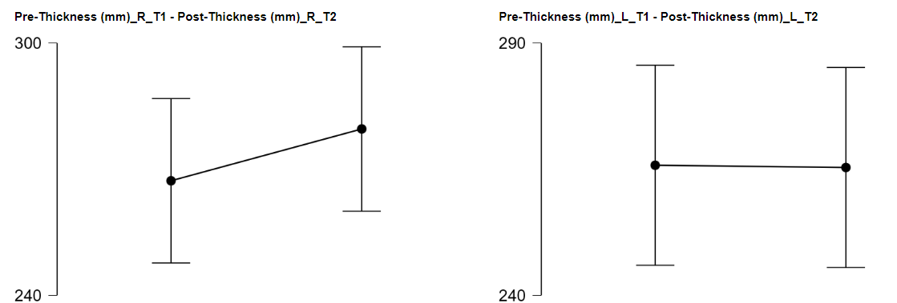
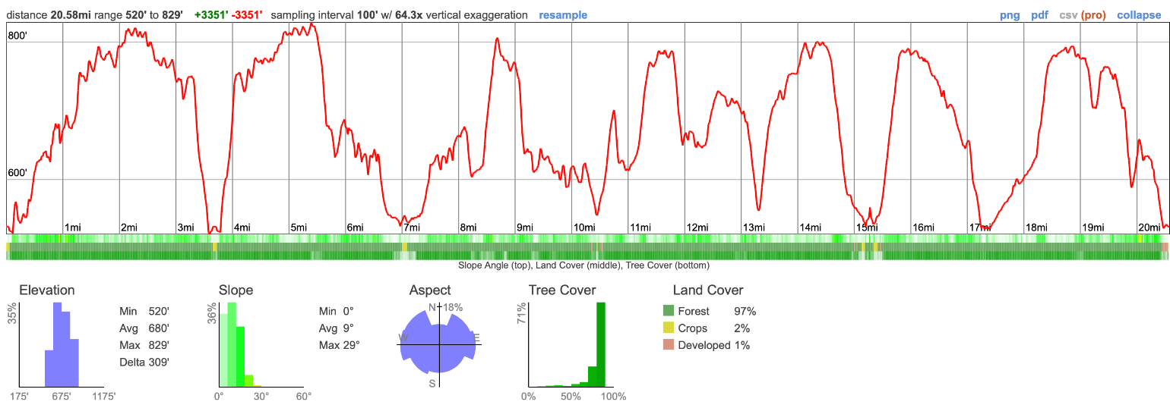
PHYSIOLOGICAL MEASUREMENTS
PRE/POST 100-MILE ENDURANCE RACE
Zavisiute, Karolina; Richmond, Scott; Kerksick, Chad, Sunderland, Kyle; Mumford, Petey
Lindenwood University, St. Charles, MO
INTRODUCTION
RESULTS
Bioelectrical Impedance (BIA)
 | Pre-race mean ± SD | Post-race mean ± SD | P value
BMI | 24.41 ± 1.27 | 24.12 ± 1.97 | 0.349
TBW% | 61.30 ± 6.40 | 63.91 ± 3.70 | 0.164
ECF% | 41.51 ± 2.53 | 43.15 ± 1.89 | 0.030
ICF% | 58.50 ± 2.53 | 56.86 ± 1.89 | 0.030
• The popularity of distance running has soared in recent decades with more people running ultra-marathons than ever before.
• The minimum ultra-marathon distance is anything above 26.2 miles.
• There are few research studies available on 100-mile distance running focused on elite/world class mountain ultra marathoners.
• There are few studies available on runners that represent recreational/non-elite runners who live and train in the Midwest.
The purpose of this study is to measure physiological changes and the impact a 100-mile endurance race can have on the body.
The only significant changes were observed in body fluids, braking force, and left/ right foot force at peak braking during countermovement jump testing.
Bell Squats & Countermovement Jump (CMJ)
CONCLUSION
Demographics
n=10 males | Mean ± SD | Minimum | Maximum
Age (years) | 36.6 ± 14.1 | 20 | 60
Height (cm) | 177.4 ± 7.2 | 165 | 186
Weight (kg) | 75.4 ± 7.1 | 64.1 | 90
VO₂ (mL/kg/min) | 52.8 ± 6.3 | 45.7 | 64.1
Average finish time | 26:10:36 | 20:39:50 | 33:27:59
Body fluid increase was due to increase in plasma volume, which is very common in marathon distance runners (Knechtle et al. 2018).
CMJ results showed significant changes in braking RDF
(pre 6570.0 ± 4832.3, post 3914.7 ± 3036.9, p= 0.007).
Significant changes observed during force at peak braking force:
left leg (pre 823.8 ± 154.6, post 716.9 ± 17.5, p= 0.029)
right leg (pre 816.5 ± 109.5, post 746.6 ± 148.5, p= 0.014).
This change can possibly be attributed to the rocky terrain on which the race took place, as well as the shock observed running down hills.
Ultra endurance trail runners are very diverse, and the location and the terrain that runners train on can have a huge impact on their performance.
METHODS
Visit 1
1-week pre-race
Visit 2
2-3 days post-race
Vastus Lateralis Muscle Morphology
Heart Rate
Body Mass
Height
Ultrasound
Biodex Balance Assessment
Resting Metabolic Rate
Body Water Assessment
Muscular Strength
VO2max
Heart Rate
Body Mass
Ultrasound
Biodex Balance Assessment
Body Water Assessment
Muscular Strength
REFERENCES
Knechtle B, Rosemann T, Nikolaidis PT. Pacing and Changes in Body Composition in 48 h Ultra-Endurance Running-A Case Study. Sports (Basel). 2018;6(4):136. Published 2018 Nov 1. doi:10.3390/sports6040136
Landers-Ramos RQ, Dondero K, Nelson C, Ranadive SM, Prior SJ, Addison O. Muscle thickness and inflammation during a 50km ultramarathon in recreational runners. PLoS One. 2022;17(9):e0273510. Published 2022 Sep 1. doi:10.1371/journal.pone.0273510
Nikolaidis PT, Clemente-Suárez VJ, Chlíbková D, Knechtle B. Training, Anthropometric, and Physiological Characteristics in Men Recreational Marathon Runners: The Role of Sport Experience. Front Physiol. 2021;12:666201. Published 2021 Apr 12. doi:10.3389/fphys.2021.666201

